Slide 1


Machine Learning 530
Introduction to Neural Machine Translation with Attention and Transformers
Steve Elston
Copyright 2018, 2019, 2022 Stephen F Elston. All rights reserved.

Slide 2
Outline
Review of recurrent neural network (RNN) architectures
The long-short term memory (LSTM) unit
Introduction to statistical machine translation (SMT)
Evaluation of STM models
Overview of neural machine translation (NMT)
The attention mechanism for NMT
Google translate
Higher capacity models with transformers

Slide 3
RNN Architectures
Feedforward network
Output
Layer
Hidden
Layers
Input
Layer

Slide 4
RNN Architectures
Generative model where input vector generates output sequence
Output
Layer
Hidden
Layers
Input
Layer

Slide 5
RNN Architectures
Classification of input sequence
Output
Layer
Hidden
Layers
Input
Layer

Slide 6
RNN Architectures
Sequence-to-sequence model – Generative
Output
Layer
Hidden
Layers
Input
Layer

Slide 7
RNN Architectures
Sequence-to-sequence model with context and embedding
Output
Layer
Hidden
Layers
Embedding Layer
Input
Layer

Slide 8
Sequence Generation with RNNs
Given an input value x, we want to generate an output sequence y.
Activation is function of input and last output: Y_{t} = h_{t-1}(y_{t-1},x)
Is a generative model
Train by minimizing the loss with respect to the desired response
Loss function = J(U, V, W)
Applications:
Response to question – chat bots
Caption images
Machine translation

Slide 9
Sequence Generation with RNNs
J ^{(t-1)}
J ^{(t)}
J ^{(t+1)}
y ^{(t)}
y ^{(t+1)}
y ^{(…)}
Y_hat^{(t-1)}
Y_hat^{(t)}
Y_hat^{(t+1)}
U
U
V
V
V
h^{(t-1)}
h^{(t)}
W
h^{(t+1)}
W
h^{(…)}
h^{(…)}
W
W
R
R
R
X ^{(t-1)}
X ^{(t)}
X ^{(t+1)}

Slide 10
Long-Short Term Memory
How can one create a neural net for modeling sequences with stable gradients?
Memory lets the NN operate at multiple time scales
Forget gates break the recurrence relationship and stabilize the gradient
The Long-Short Term Memory (LSTM) neural network was an early architecture using memory and forget gates
LSTM used for speech recognition, handwriting generation, machine translation, etc.

Slide 11
Long-Short Term Memory
Output
X
Self Loop
+
X
W
State
X
Input Gate
Forget Gate
Output Gate
U
Input

Slide 12
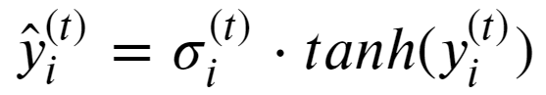
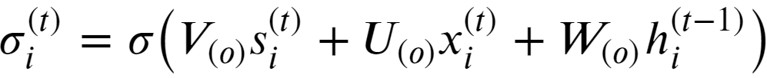
Long-Short Term Memory
Output
Output of LSTM unit
Activation of output gate
X
Self Loop
+
X
W
State
X
Input Gate
Forget Gate
Output Gate
U
Input

Slide 13
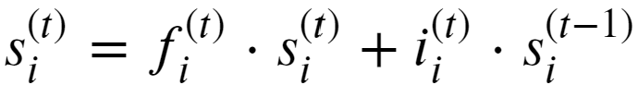
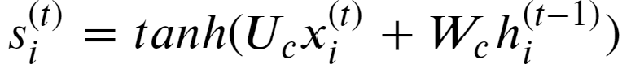
Long-Short Term Memory
Output
State of the memory loop
Update of memory state
X
Self Loop
+
X
W
State
X
Input Gate
Forget Gate
Output Gate
U
Input

Slide 14
Long-Short Term Memory
Output
Activation of the forget gate
Activation of the input gate
X
Self Loop
+
X
W
State
X
Input Gate
Forget Gate
Output Gate
U
Input

Slide 15
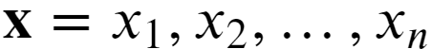
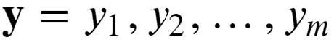
Statistical Machine Translation
How to build a statistical model to translate from one language to another?
Statistical machine translation has a long history, starting in the 1950s
Goal:
Given an input sequence, , of tokens in a first language
Find the most probable target output sequence,
, in a second language

Slide 16
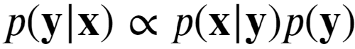
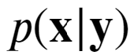
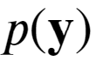
Statistical Machine Translation
How to build a statistical model to translate from one language to another?
The most probability of the output sequence y, given the input sequence x follows this relationship
Where,
is the translation model, or likelihood of sequence x given sequence y
is the language model, or probability of sequence y in the target language

Slide 17
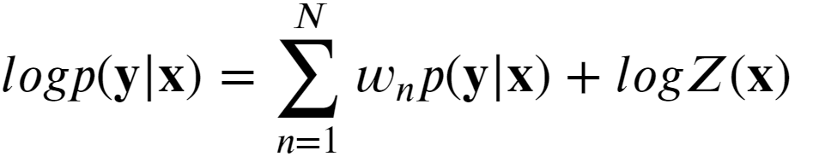
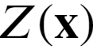
Statistical Machine Translation
How to build a statistical model to translate from one language to another?
Find most probably target sequence
Can find weights for the maximum likelihood expression
Where is the normalization constant not dependent on y

Slide 18
Evaluation of SMT Models
The BLEU score
The Bilingual Translation Understudy or BLEU score is used to compare SMT models.
BLEU is a comparison between results of an SMT model and results of expert human translators
The BLEU compares a hypothesis of i-gram tuples, H(i)
The BLEU is the average proportion of i-gram matches
A model with a higher BLEU is considered superior

Slide 19
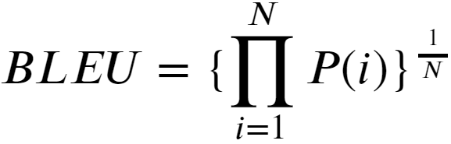
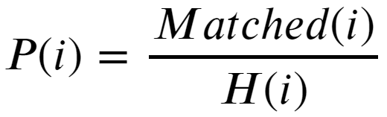
Evaluation of SMT Models
The BLEU score
The BLEU score for a sequence length N is computed:
Where,

Slide 20
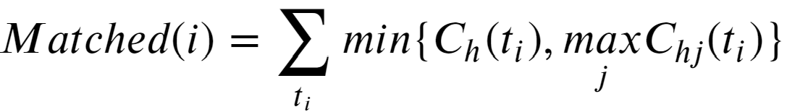
Evaluation of SMT Models
The BLEU score
H(i) is the number of i-gram tuples in each hypothesis
For hypothesis of length n, examples are: H(1) = n, H(2) = n-1, H(3) = n-2
And the number of matches:
Where, for i-gram tuple t_{i}
C_{h}(t_{i}) = number of times t_{i} occurs in the hypothesis to be tested
C_{hj}(t_{i}) = number of times t_{i} occurs in the j-th reference

Slide 21
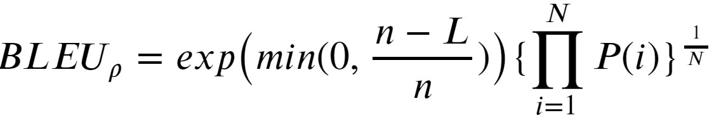
Evaluation of SMT Models
The BLEU score
The BLEU score is dependent on the sequence length
A commonly used adjustment is the brevity penalty, ρ
The adjusted BLEU score is then:
Where:
n = length of the hypothesis
L = length of the reference sequence

Slide 22
Evaluation of SMT Models
BLEU score example
Start with French sentence:
La voiture est dans l’allée.
An expert English translation is:
The car is in the drive.

Slide 23
Evaluation of SMT Models
BLEU score example
Start with the expert English translation:
The car is in the drive.
There are 6 -1 = 5, 2-grams for this sentence:
A perfect MT is identical so:
Matched = 5
H(2) = 5
ρ = 1.0
BLEU = 100.0%
Reference 2-grams
The car
Car is
Is in
In the
The drive

Slide 24
Evaluation of SMT Models
BLEU score example
A possible MT is:
The drive contains the car.
There are 5 -1 = 4, 2-grams for this sentence:
Matched = 2
H(2) = 5
n = 6
l = 5
ρ = 1.18
BLEU = 47.3%
Reference 2-grams
The car
Car is
Is in
In the
The drive
MT 2-grams
The drive
Drive contains
Contains the
The car
Match
1
0
0
1

Slide 25
Neural Machine Translation
Use neural networks as function approximators for machine translators
Architecture has three components:
Encoder for the input sequence
Context vector – a hidden state
Decoder generates output sequence
Finds maximum likelihood target sequence
Concept introduced by Cho, et.al., 2015, Describing Multimedia Content using Attention-based Encoder--Decoder Networks

Slide 26
NMT Architectures
Encoder-decoder model with context vector
…
y_{m}
y₂
y₁
Output sequence
…
…
Decoder
…
Encoder
Context
Input sequence
x₁
x₂
x_{n}

Slide 27
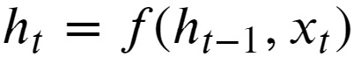
Neural Machine Translation
Use neural networks as function approximators for machine translators
The hidden state updates as a function last hidden state and input
Where, f() is the activation function of the LSTM
The encoder creates a sequence of hidden states given the input sequence

Slide 28
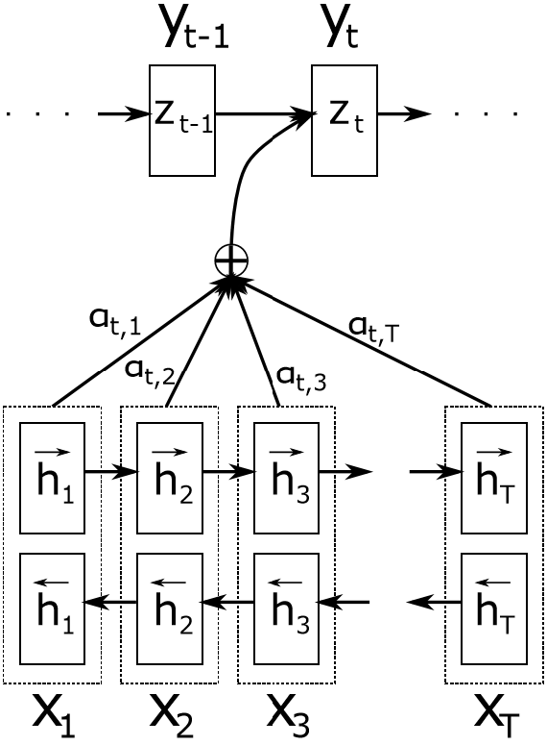
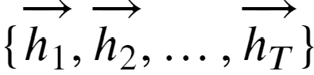
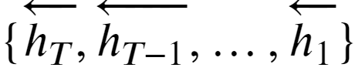
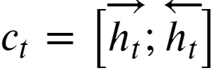
Neural Machine Translation
Use neural networks as function approximators for machine translators
The first layers of a NMT encoder network are a bidirectional RNN (BiRNN)
The hidden states of the forward layer are:
The hidden states of the reverse layer are:
And, the context is:
From Cho, et.al., 2015

Slide 29
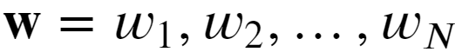
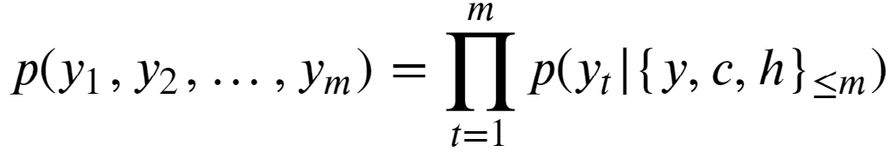
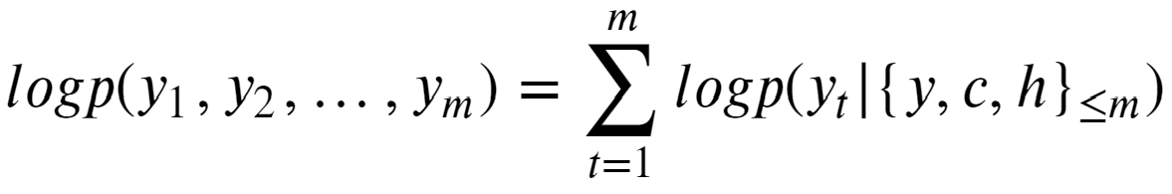
Neural Machine Translation
Use neural networks as function approximators for machine translators
Given weights, , the encoder uses the context and its hidden state
Taking logs of both sides, gives:

Slide 30
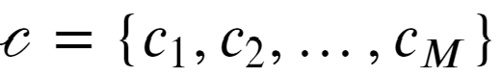
Attention Mechanism
Context is the input to decoder
A fixed context vector has limited representation
May compress information required for sequence generation
Translation accuracy decreases with sequence length
Need a better representation!
Use a context set:
The weights of the context give attention to the correct sequence in the decoder

Slide 31
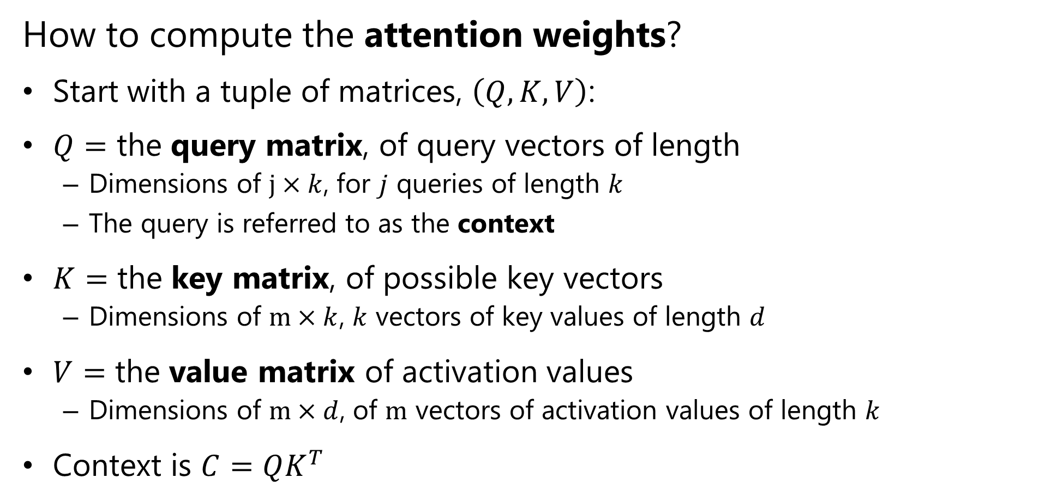
Attention Mechanism
How to compute the attention weights?
Start with a tuple of matrices, $\left(Q,K,V\right)$:
$Q=$ the query matrix, of query vectors of length
Dimensions of $j×k$, for $j$ queries of length $k$
The query is referred to as the context
$K=$ the key matrix, of possible key vectors
Dimensions of $m×k$, $k$ vectors of key values of length $d$
$V=$ the value matrix of activation values
Dimensions of $m×d$, of $m$ vectors of activation values of length $k$
Context is $C=QK^{T}$

Slide 32
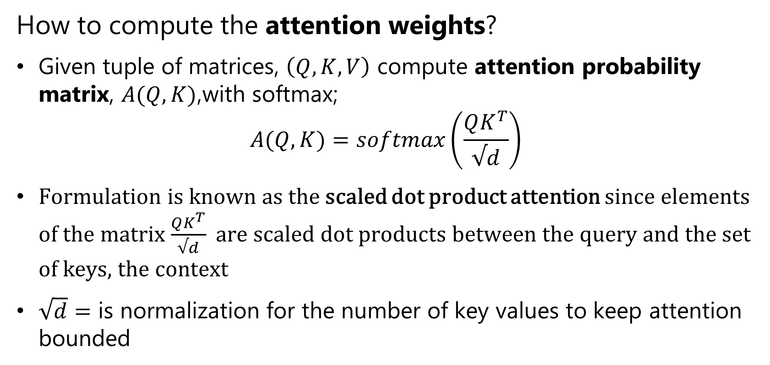
Attention Mechanism
How to compute the attention weights?
Given tuple of matrices, $\left(Q,K,V\right)$ compute attention probability matrix, $A(Q,K)$,with softmax;
$$A(Q,K)=softmax\left(\frac{QK^{T}}{√d}\right)$$
Formulation is known as the scaled dot product attention since elements of the matrix $\frac{QK^{T}}{√d}$ are scaled dot products between the query and the set of keys, the context
$\sqrt{d}=$ is normalization for the number of key values to keep attention bounded
Notes:
The

Slide 33
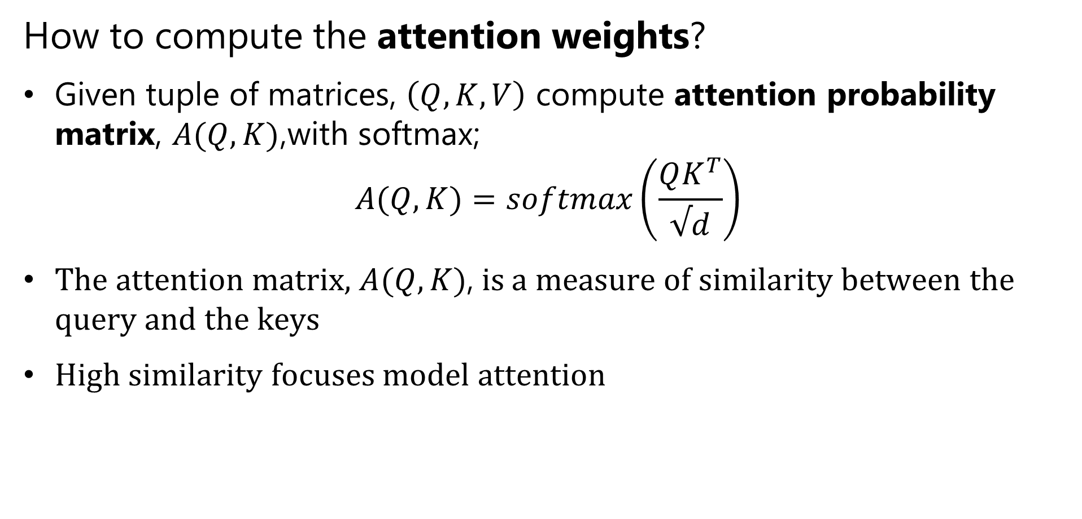
Attention Mechanism
How to compute the attention weights?
Given tuple of matrices, $\left(Q,K,V\right)$ compute attention probability matrix, $A(Q,K)$,with softmax;
$$A(Q,K)=softmax\left(\frac{QK^{T}}{√d}\right)$$
The attention matrix, $A(Q,K)$, is a measure of similarity between the query and the keys
High similarity focuses model attention
Notes:
The

Slide 34
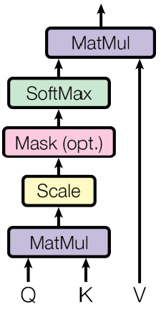
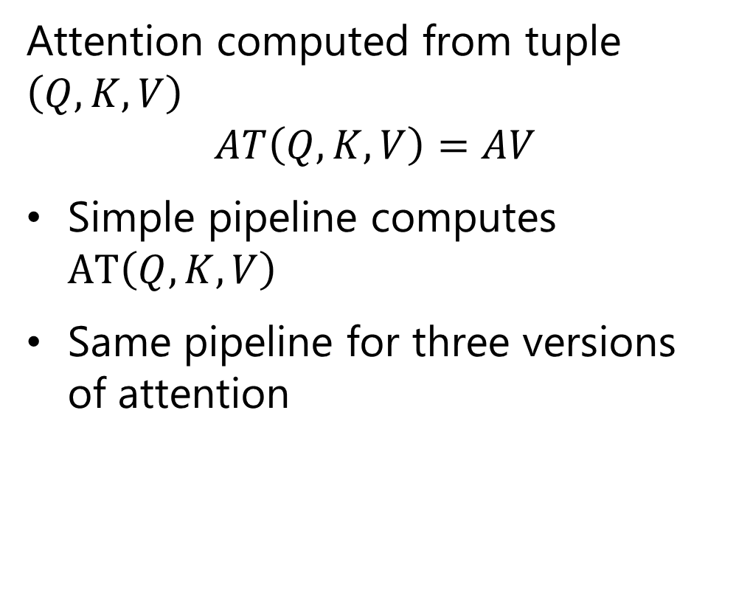
Attention Architecture
Basic attention model
Attention computed from tuple $\left(Q,K,V\right)$
$$AT\left(Q,K,V\right)=AV$$
Simple pipeline computes $AT\left(Q,K,V\right)$
Same pipeline for three versions of attention
From Vaswani, et.al., 2017

Slide 35
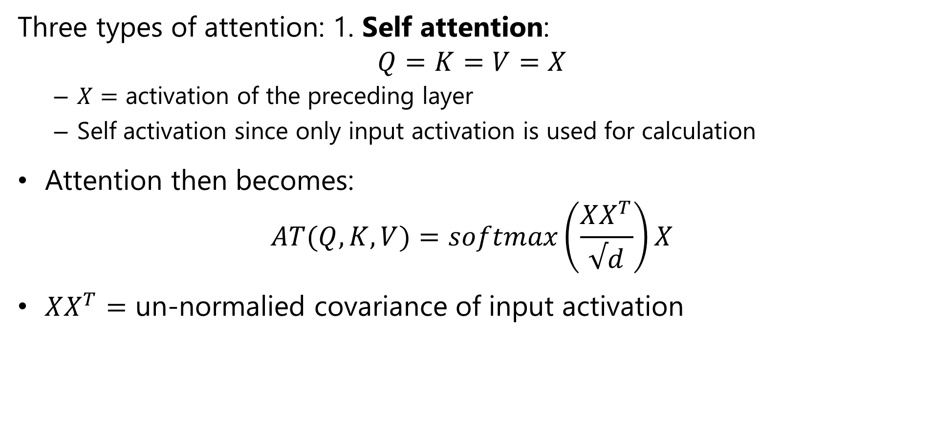
Attention Mechanism
Three types of attention: 1. Self attention:
$$Q=K=V=X$$
$X=$ activation of the preceding layer
Self activation since only input activation is used for calculation
Attention then becomes:
$$AT(Q,K,V)=softmax\left(\frac{XX^{T}}{√d}\right)X$$
$XX^{T}=$ un-normalied covariance of input activation
Notes:
The

Slide 36
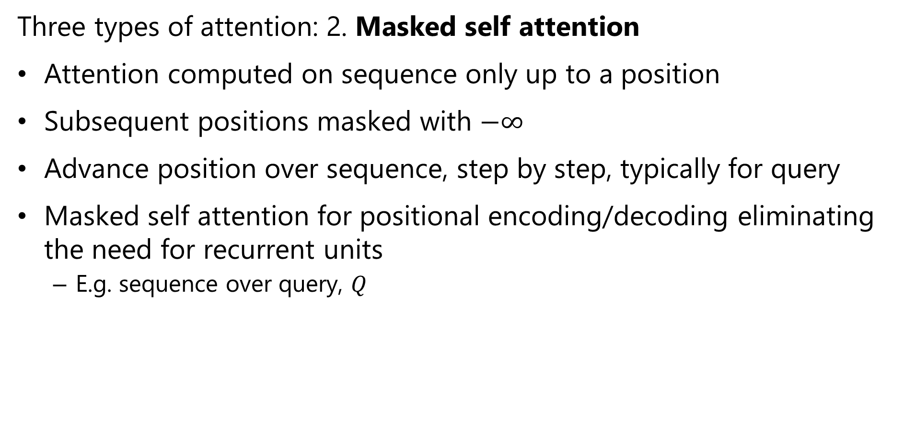
Attention Mechanism
Three types of attention: 2. Masked self attention
Attention computed on sequence only up to a position
Subsequent positions masked with $−∞$
Advance position over sequence, step by step, typically for query
Masked self attention for positional encoding/decoding eliminating the need for recurrent units
E.g. sequence over query, $Q$
Notes:
The

Slide 37
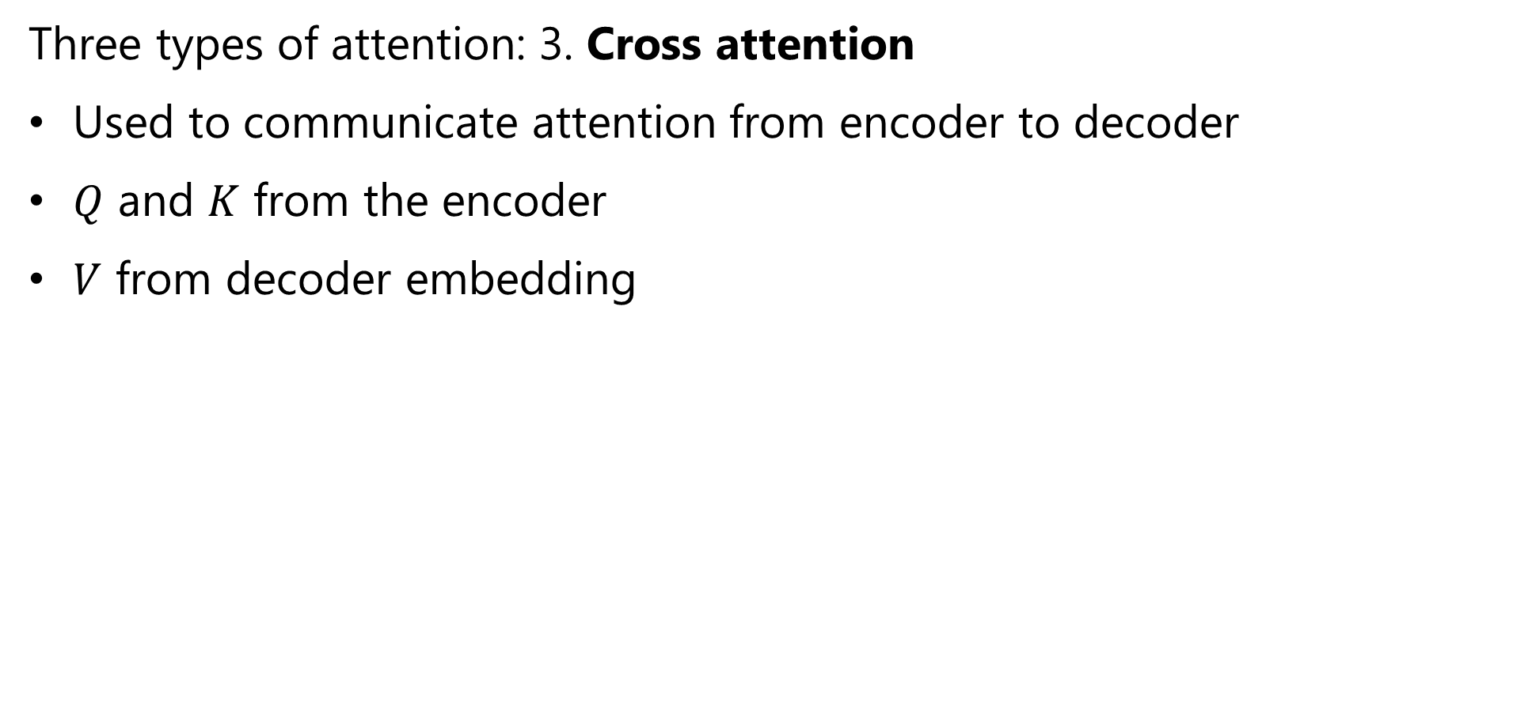
Attention Mechanism
Three types of attention: 3. Cross attention
Used to communicate attention from encoder to decoder
$Q$ and $K$ from the encoder
$V$ from decoder embedding
Notes:
The

Slide 38
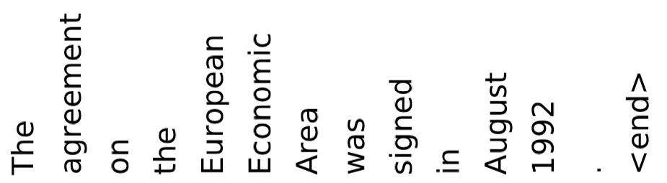
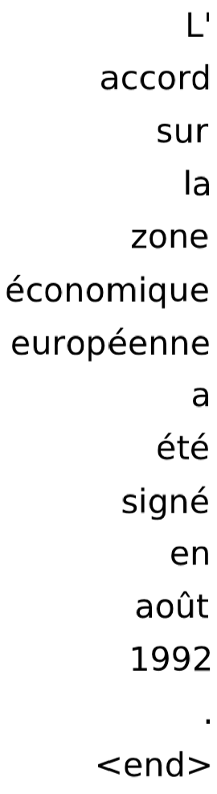

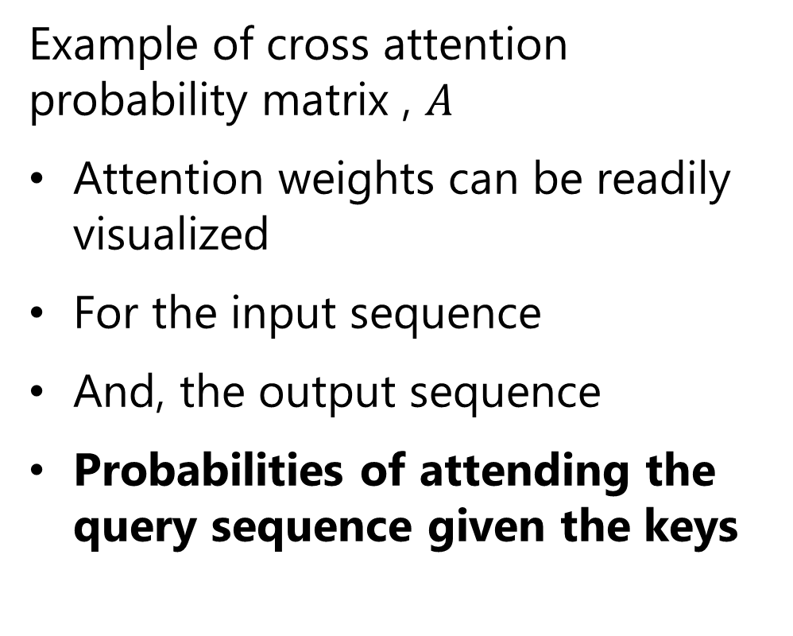
Attention Mechanism
Example of cross attention probability matrix , $A$
Attention weights can be readily visualized
For the input sequence
And, the output sequence
Probabilities of attending the query sequence given the keys
Cho, et. al, Describing Multimedia Content using Attention-based Encoder–Decoder Networks, 2015

Slide 39
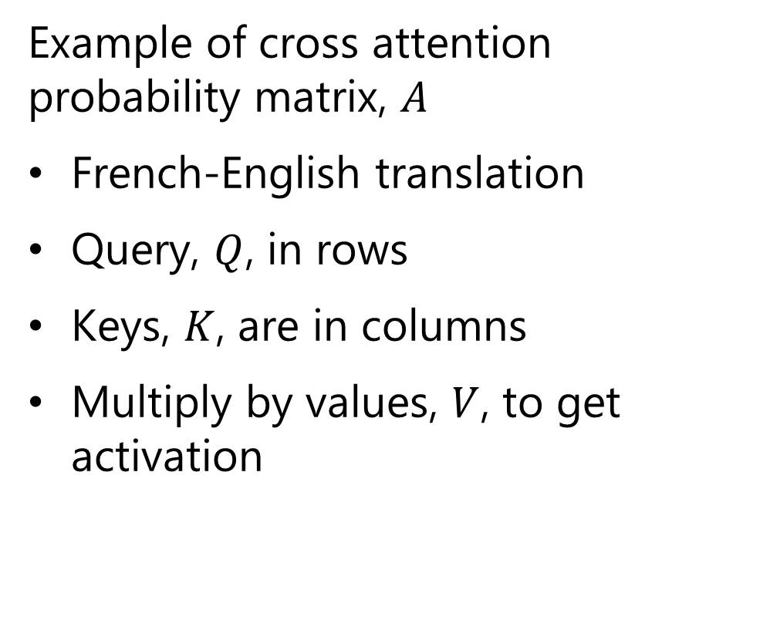
Attention Mechanism
Example of cross attention probability matrix, $A$
French-English translation
Query, $Q$, in rows
Keys, $K$, are in columns
Multiply by values, $V$, to get activation
Cho, et. al, Describing Multimedia Content using Attention-based Encoder–Decoder Networks, 2015

Slide 40
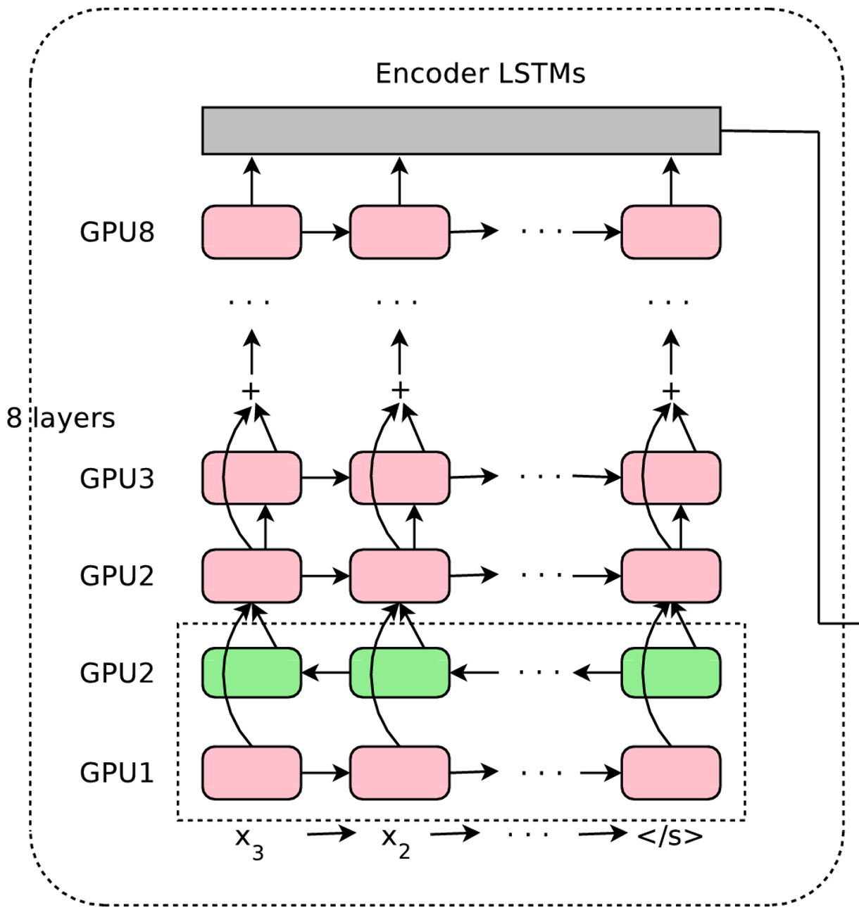
Google Translate
Google Translate architecture: Encoder
Context vectors
6 unidirectional RNN layers
Bidirectional RNN layers
Input sequence
Wu, et. al, Google’s Neural Machine Translation System: Bridging the Gap between Human and Machine Translation, 2016

Slide 41
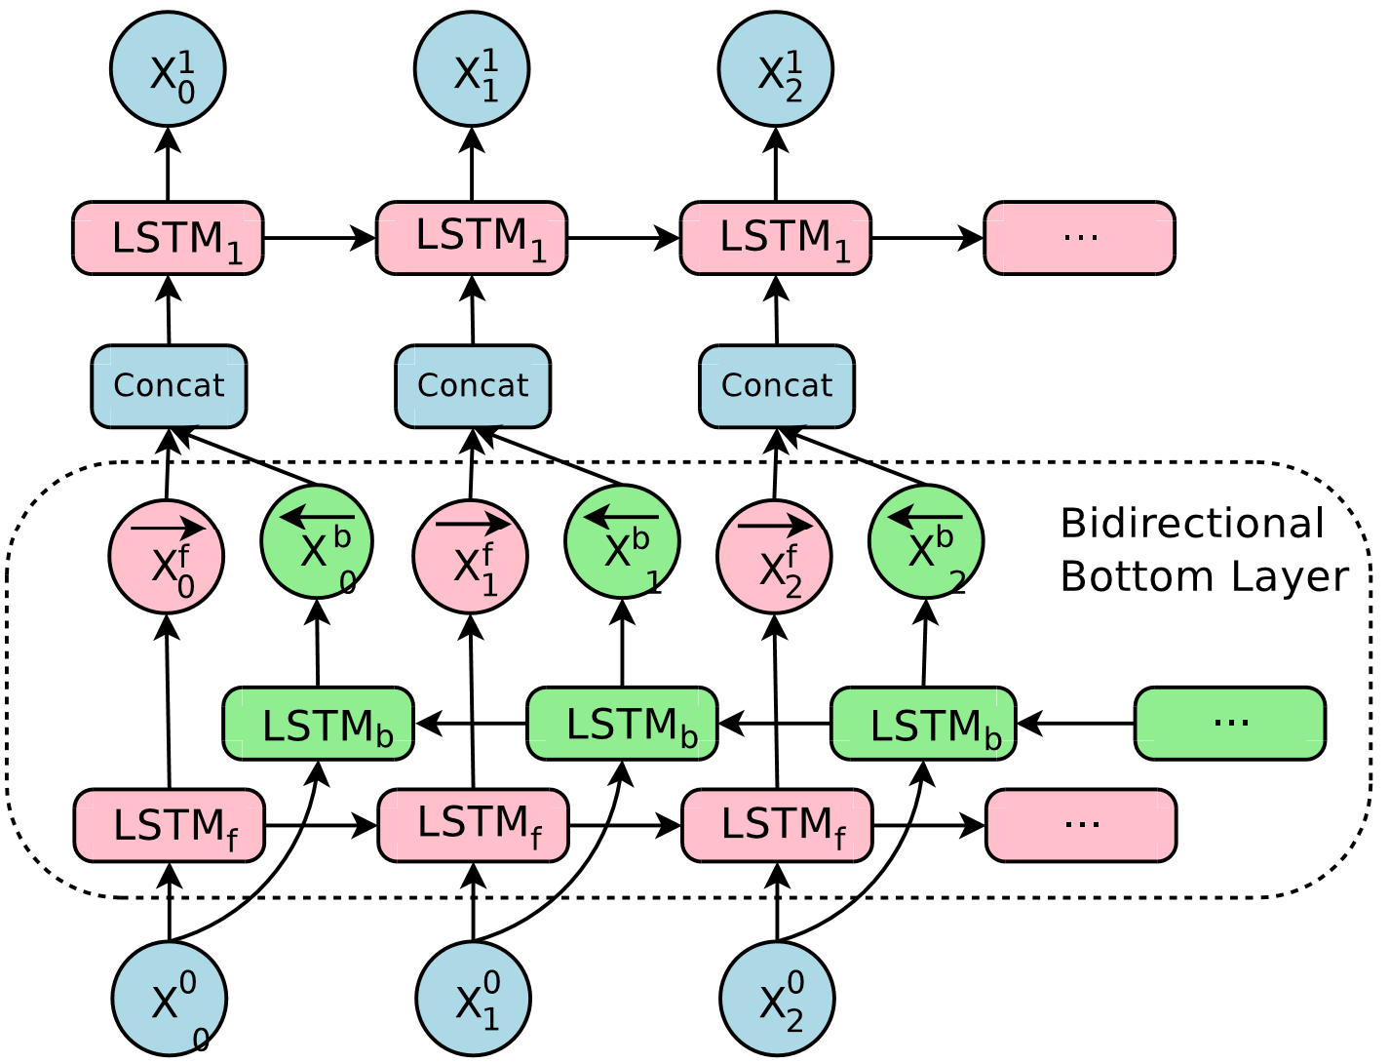
Google Translate
Google Translate architecture
Details of the biRNN layer
Wu, et. al, Google’s Neural Machine Translation System: Bridging the Gap between Human and Machine Translation, 2016

Slide 42
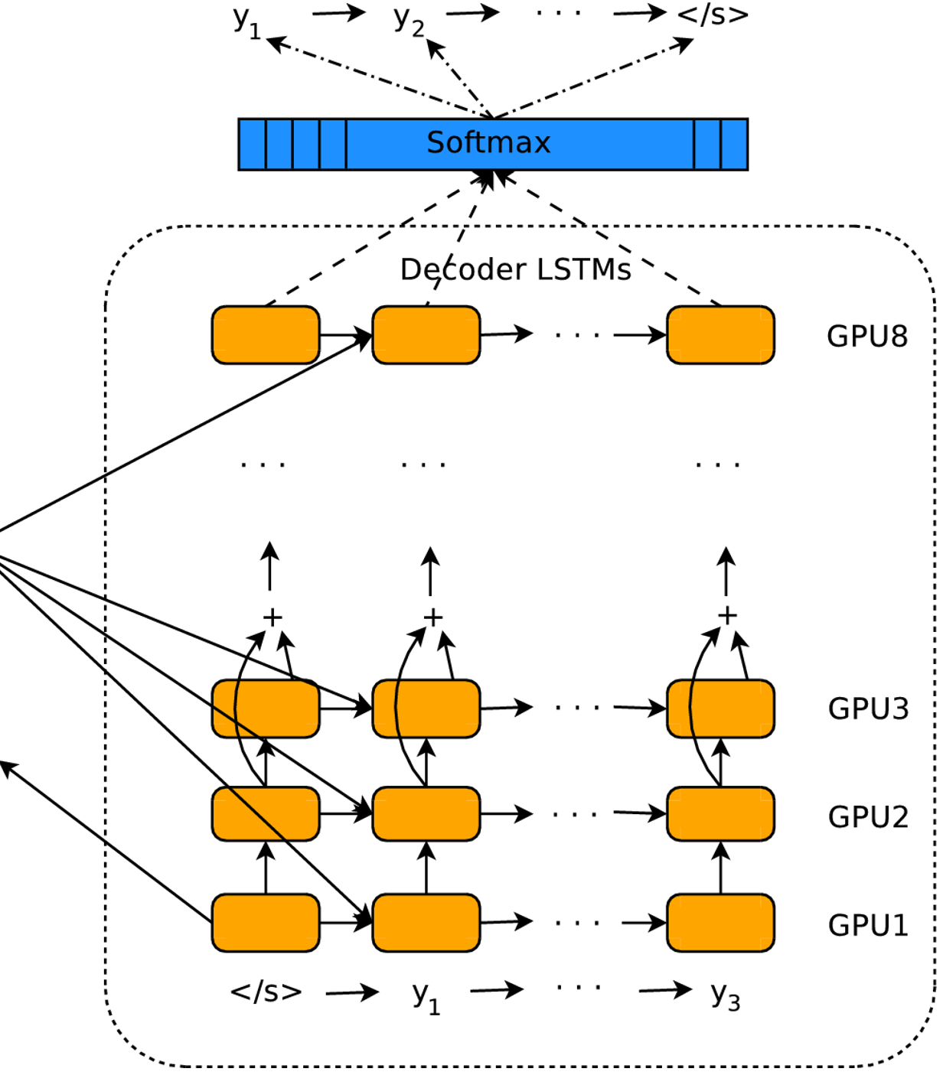
Google Translate
Google Translate architecture: Decoder
Output sequence
Softmax layer
8 RNN layers
Wu, et. al, Google’s Neural Machine Translation System: Bridging the Gap between Human and Machine Translation, 2016

Slide 43
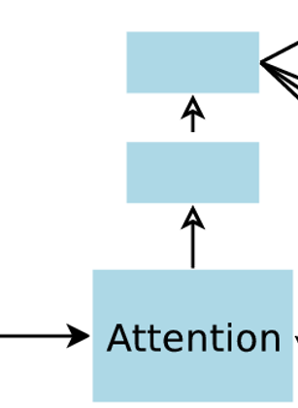
Google Translate
Google Translate architecture
Wu, et. al, Google’s Neural Machine Translation System: Bridging the Gap between Human and Machine Translation, 2016

Slide 44
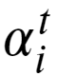
Beam Search in Decoder
Use the beam search method to find the most probable output sequence
Given the attention probabilities, , how can the decoder find the most probable output sequence?
Use a search heuristic known as beam search
Beam search is a classic AI method originating in the 1970s
Beam search is a breath first search method
Search along k highest probability paths
Search breath limited to a ‘beam’ around current value
Uses less memory than full breath search

Slide 45
Google Translate
Beam search for the attention mechanism
Beam search used to find the sequence with the highest probability or likelihood
Need a decoder which does not favor particular output sequence
Standard likelihood score needs adjustments
Do not want to favor short sequences resulting from the summation of negative log likelihoods
Need to ensure that the entire input sequence is reflected in the output sequence

Slide 46
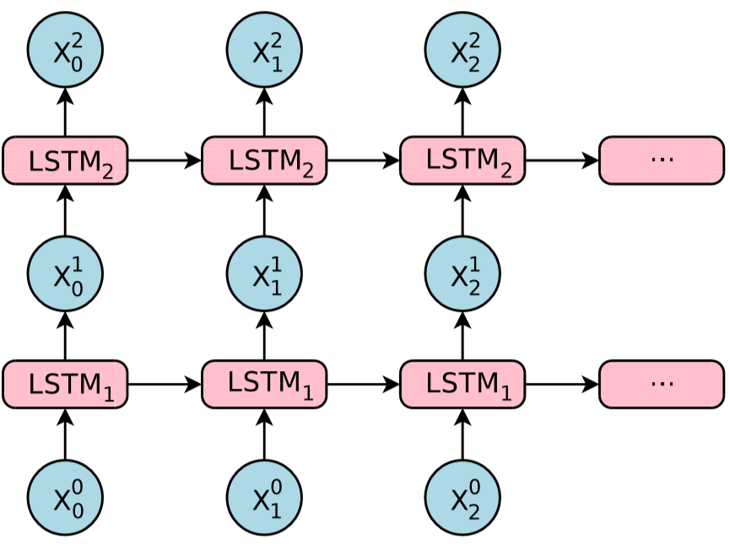
Google Translate
How to train deep LSTM RNNs?
Stacking many LSTM layers is problematic
Gradient vanishes
Solution: use residual connections!
Wu, et. al, Google’s Neural Machine Translation System: Bridging the Gap between Human and Machine Translation, 2016

Slide 47
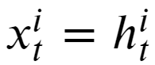
Google Translate
How to train deep LSTM RNNs?
The following relations govern the update between the i-th and i+1-th standard LSTM layers:
Where, for the i-th layer:
m_{i} = the LSTM memory
h_{i} = hidden state
x_{i} = input
W_{i} = weight tensor

Slide 48
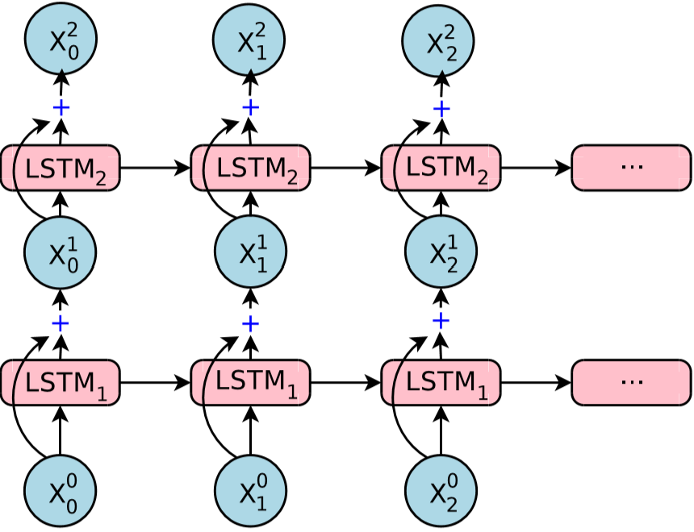
Google Translate
Google Translate architecture: residual connections
How to deal with vanishing gradient in deep RNN?
Use residual connections
Residual connections
Wu, et. al, Google’s Neural Machine Translation System: Bridging the Gap between Human and Machine Translation, 2016

Slide 49
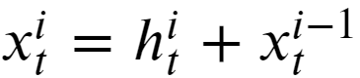
Google Translate
How to train deep LSTM RNNs?
The following relations govern the update between the i-th and i+1-th standard LSTM layers
< residual connection
Residual connection was first introduced for convolutional layers in ResNet

Slide 50
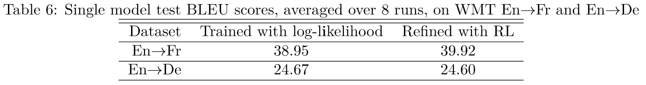
Google Translate
How well does it work?
Compare BLEU scores with and without reinforcement learning fine tuning
Simple NMT models have BLEU scores less than 40 for En-> FR
Wu, et. al, Google’s Neural Machine Translation System: Bridging the Gap between Human and Machine Translation, 2016

Slide 51
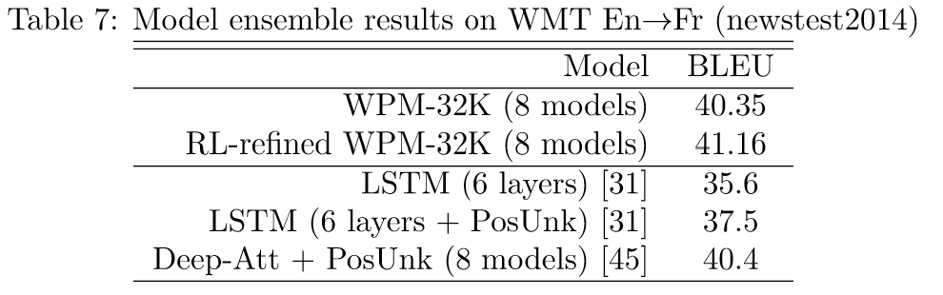
Google Translate
How well does it work?
Using an ensemble of models helps:
Wu, et. al, Google’s Neural Machine Translation System: Bridging the Gap between Human and Machine Translation, 2016

Slide 52
Transformer Architectures
Transformer architecture overcomes limitations of basic attention
Sequence-to-sequence attention models use LSTM
LSTM only works over limited sequence length
Context in sequences can be long-range
Recall the forget loop limits range
Attention model only allows one context
We need a higher capacity model!

Slide 53
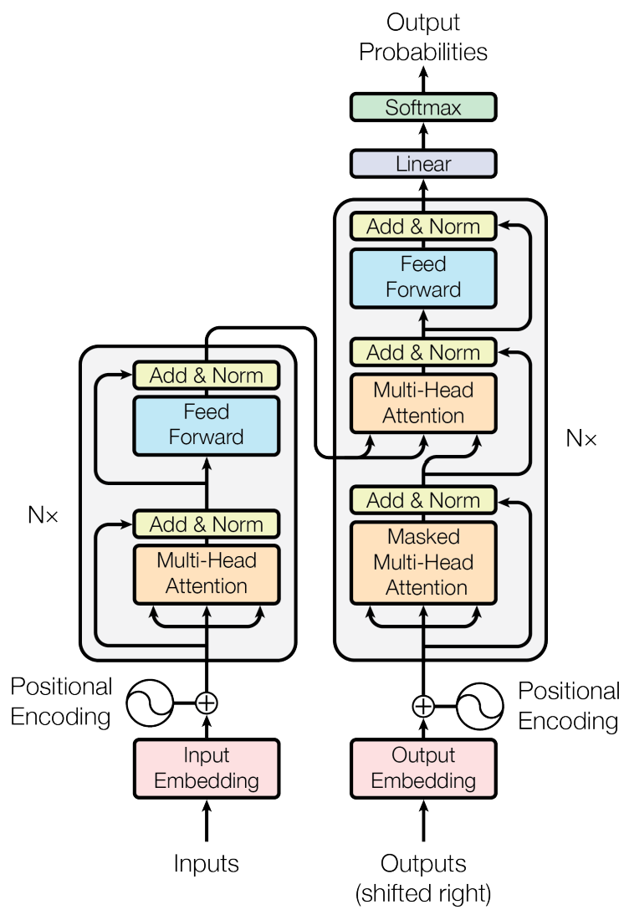
Transformer Architectures
Transformer architecture overcomes limitations of basic attention
Basic transformer architecture introduced by Vaswani, et.al., 2017
Uses an encoder-decoder architecture
Incorporates multi-head attention for greater model capacity

Slide 54
Transformer Architectures
Basic transformer architecture introduced by Vaswani, et.al., 2017
Uses three types of attention
Self attention in encoder
Masked self attention for decoder output
Cross attention in decoder
Residual loops for attention and feed forward layers
Idea used in earlier LSTM-based attention models
Introduced in Resnet architecture

Slide 55
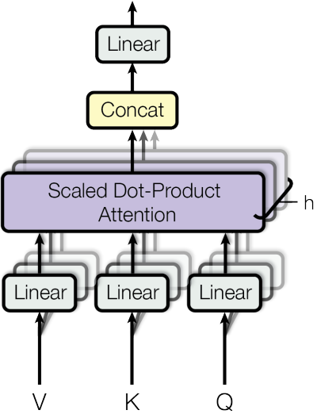
Multi-Head Attention
Multi-head attention adds model capacity
Attention layer has multiple attention heads to increase model capacity
Multi-head attention differentiates transforms from earlier attention models
Each head learns different attention map
Analogous approach to increasing model capacity with multi-channel convolutional layers

Slide 56
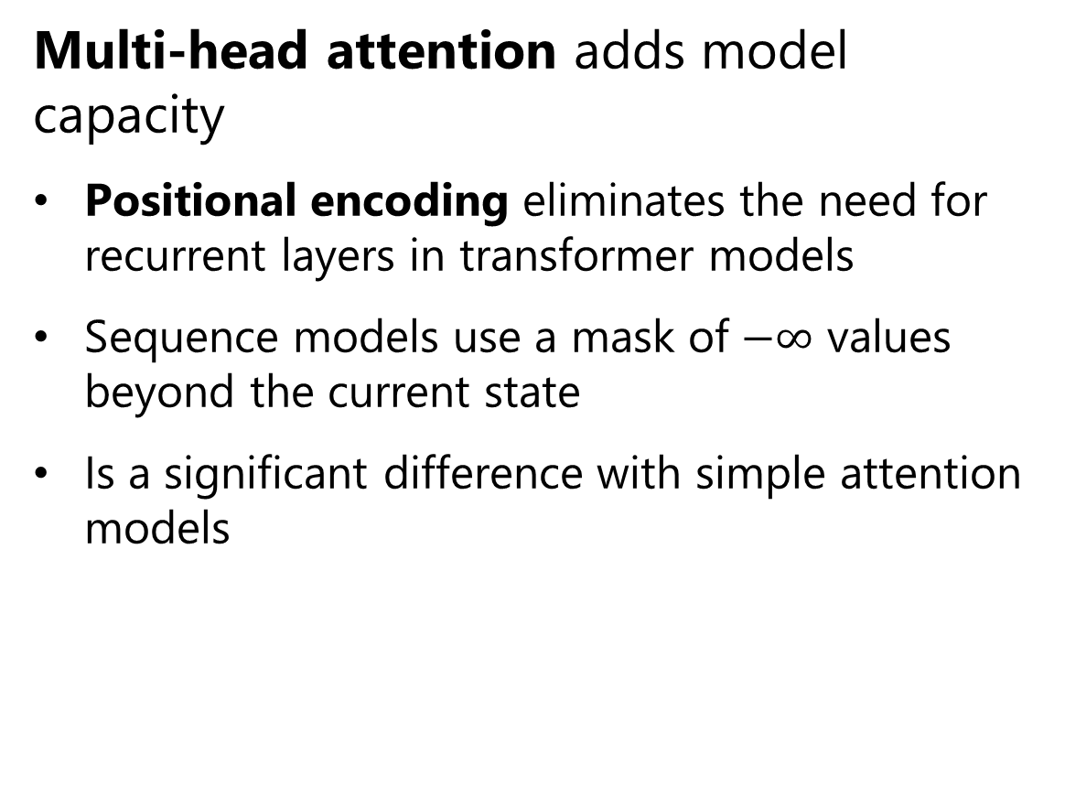
Multi-Head Attention
Multi-head attention adds model capacity
Positional encoding eliminates the need for recurrent layers in transformer models
Sequence models use a mask of $−∞$ values beyond the current state
Is a significant difference with simple attention models

Slide 57

Multi-Head Attention
Multi-head attention adds model capacity
Multi-head attention uses weighted tuple, $\left(QW_{ }^{Q},KW_{ }^{K},VW_{ }^{V}\right)$, for each head
For head index, $i∈\{1,n\}$, the ith attention tensor component is:
$$A_{i}(QW_{i}^{Q},KW_{i}^{K})=softmax\left(\frac{Q{\left(KW_{i}^{Q}W_{i}^{K}\right)}^{T}}{√d}\right)$$
And, ith attention activation is:
$${AT}_{i}\left(QW_{i}^{Q},KW_{i}^{K},VW_{i}^{V}\right)=A_{i}W_{i}^{V}V$$

Slide 58

Multi-Head Attention
Multi-head attention adds model capacity and complexity
High model complexity with learnable weight tensors $\left(W_{ }^{Q},W_{ }^{K},W_{ }^{V}\right)$
Learning by backpropagation
Three regularization methods applied:
Batch normalization following residual loop
Dropout regularization before summing in residual loop and following positional embedding
Label smoothing to eliminate 0s following one-hot encoding

Slide 59

Multi-Head Attention
Multi-head attention adds model capacity and complexity
Multi-head attention uses weighted tuple, $\left(QW_{ }^{Q},KW_{ }^{K},VW_{ }^{V}\right)$, for each head
For n heads, dimensions are now:
$Q$- Dimensions of $n×j×k$, for $n$ queries of length $k$
$K$ - Dimensions of $n×m×k$, $n×k$ vectors of key values of length $d$
$V$ - Dimensions of $n×m×d$, of $n×m$ vectors of activation values of length $k$
High model complexity with learnable weight tensors $\left(W_{ }^{Q},W_{ }^{K},W_{ }^{V}\right)$
Basic transformer models require massive dataset size!

Slide 60

Multi-Head Attention
Multi-head attention adds model capacity and complexity
High model complexity with learnable weight tensors $\left(W_{ }^{Q},W_{ }^{K},W_{ }^{V}\right)$
Attention of every key element to every query element is results in dense tensors, $\left(W_{ }^{Q},W_{ }^{K},W_{ }^{V}\right)$, resulting in slow training
Since original transformer paper, many ideas tried to reduce complexity of model and speed training
We will review only sparse attention matrix methods

Slide 61

Multi-Head Attention
Multi-head attention adds model capacity and complexity
The basic attention matrix can be represented as a fully connected bipartite graph
Every element of one set is connect to every element of the other set

Slide 62

Multi-Head Attention
Reducing complexity of attention matrix
Several possibilities for creating sparse attention matrices
Global attention matrix models long-range dependencies
Equivalent bipartite graph has many fewer connections (weights)
From A Survey of Transformers Lin, et.al., 2021

Slide 63

Multi-Head Attention
Reducing complexity of attention matrix
Several possibilities for creating sparse attention matrices
Band attention matrix models local dependencies
Equivalent bipartite graph has sparse connections (weights)
From A Survey of Transformers Lin, et.al., 2021

Slide 64

Multi-Head Attention
Reducing complexity of attention matrix
Several possibilities for creating sparse attention matrices
Dilated attention matrix models dependencies less local than simple band attention
Sampling gives bipartite graph as sparse as band attention matrix
From A Survey of Transformers Lin, et.al., 2021

Slide 65

Multi-Head Attention
Reducing complexity of attention matrix
Several possibilities for creating sparse attention matrices
Block attention matrix creates attention for groups
Represented by small fully connected bipartite graph
From A Survey of Transformers Lin, et.al., 2021

Slide 66

Multi-Head Attention
Reducing complexity of attention matrix
Several possibilities for creating sparse attention matrices
Random attention matrix randomly samples attention relationships
Multi-head random sampled attention is a form of ensemble model
From A Survey of Transformers Lin, et.al., 2021

Slide 67

Multi-Head Attention
Reducing complexity of attention matrix
Can create combinations of simple sparse matrices to appropriate for purpose
From A Survey of Transformers Lin, et.al., 2021

Slide 68

Great many transformer models have been tried!
Vaswani, et.al., 2017 sparked a great many research directions
Mid-2021 taxonomy of transformer architectures from Lin, et.al., 2021
Applications in NLP, computer vison, speech recognition, etc.

Slide 69
Transformer Architectures
How many multi-head attention units can we have?
Many!
Transformer architectures stack multi-head attention modules:
Increases model capacity
Requires larger training data sets
Leads to greater over-fitting

Slide 70

Transformer Architectures
Example of state-of-the-art architecture is the switch transformer, Fedus, et. al. 2021

Slide 71

Transformer Architectures
Example of state-of-the-art architecture is the switch transformer, Fedus, et. al. 2021
Architecture stacks many switched attention modules
Modules switch feed forward network based on context
Switching context allows greater capacity, e.g. multi-language models
Positional embedding used in encoder and decoder layers

Slide 72
Transformer Architectures
Example of state-of-the-art architecture is the switch transformer, Fedus, et. al. 2021
Architecture stacks many switched attention modules
Using many switched context models leads to trillions of learnable parameters!
Requires massive data and computing resources to train!

Slide 73
Summary
Review of recurrent neural network (RNN) architectures
The long-short term memory (LSTM) unit
Introduction to statistical machine translation (SMT)
Evaluation of STM models
Overview of neural machine translation (NMT)
The attention mechanism for NMT
Google translate
Higher capacity models with transformers

